Slide 1
Winter Term 21/22 Adversarial Self-Supervised Learning with Digital Twins Lecture-6: Safe RL
Prof. Dr. Holger Giese (holger.giese@hpi.uni-potsdam.de)
Christian Medeiros Adriano (christian.adriano@hpi.de) - “Chris”
He Xu (he.xu@hpi.de)

Slide 2
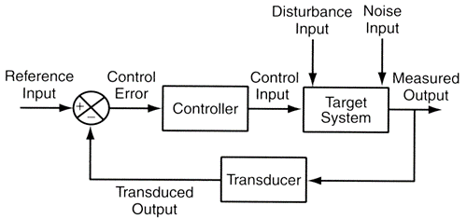
Infrastructure to run experiments
“Success in the Lab is not guarantee of Success in the World.”
Feedback loop models
"When solving a problem of interest, do not solve a more general problem as an intermediate step. Try to get the answer that you really need but not a more general one." Vladimir Vapnik
Simulation models
"Thinking is acting in an imagined space" Konrad Lorenz
"Perception is a generative act" – [Gross et al. 1999]
" Consciousness is a controlled hallucination " - [Seth et al. 2000]
System State and Configurations
Intelligent System
Digital Twin
New Model Parameters
Success in the World == learn safely or at least be robust to changes

Slide 3
Concrete Problems in AI Safety: Wrong Means to an End
Avoiding Negative Side Effects: How can we ensure that our cleaning robot will not disturb the environment in negative ways while pursuing its goals. Knocking over a vase because it can clean faster by doing so? Can we do this without manually specifying everything the robot should not disturb?
mRubis: While optimizing for risk, make myopic decisions only based on average utility, ignoring the shape of the distribution, which might render some components riskier to fix than others.
.
source: Amodei et al., 2016, Concrete Problems in AI Safety
Notes:
Amodei et al., 2016, Concrete Problems in AI Safety - https://arxiv.org/abs/1606.06565

Slide 4
Concrete Problems in AI Safety: Wrong Means to an End
Avoiding Reward Hacking: How can we ensure that the cleaning robot won't game its reward function? For example, if we reward the robot for achieving an environment free of messes, it might disable its vision so that it won’t find any messes up or covers over messes with materials it can't see through, or simply hide when humans are around so they can’t see.
mRubis: While comparing the outcomes of multiple agents w.r.t. their cumulative reward, one agent might put the system on a state of constant repair because that would trigger more repair actions, hence more cumulative utility being produced.
source: Amodei et al., 2016, Concrete Problems in AI Safety
Notes:
Amodei et al., 2016, Concrete Problems in AI Safety - https://arxiv.org/abs/1606.06565

Slide 5
Concrete Problems in AI Safety: Prior Knowledge for Safety?
Scalable Oversight: How can we efficiently ensure that the cleaning robot respects aspects of the objective that are too expensive to be frequently evaluated during training? For instance, it should throw out things that are unlikely to belong to anyone but put aside things that might belong to someone (it should handle stray candy wrappers differently from stray cellphones). i.e., can the robot find a way to do the right thing despite limited information?
mRubis: While optimizing for reward adjusted to risk, how to correctly compute it for rare events? For instance, two real failures masking a third failure, or a cyclic dependency that can only be broken by a complete system restart.
source: Amodei et al., 2016, Concrete Problems in AI Safety
Notes:
Amodei et al., 2016, Concrete Problems in AI Safety - https://arxiv.org/abs/1606.06565

Slide 6
Concrete Problems in AI Safety – what is safe?
Safe Exploration: How do we ensure that the cleaning robot doesn't make exploratory moves with very bad repercussions? For example, the robot should experiment with mopping strategies, but putting a wet mop in an electrical outlet is a very bad idea.
mRubis: When optimizing for cost, make myopic decisions on number of component instances, which might cause frequent low response time and consequent crashes on depending components.
source: Amodei et al., 2016, Concrete Problems in AI Safety

Slide 7
Concrete Problems in AI Safety – what is safe?
Robustness to Distributional Shift: How do we ensure that the cleaning robot recognizes, and behaves robustly, when in an environment different from its training environment? For example, strategies it learned for cleaning an office might be too dangerous on a factory workfloor.
mRubis: change the distribution of the probabilities in the failure models, so the agent now operates with mismatch model of the environment.
source: Amodei et al., 2016, Concrete Problems in AI Safety

Slide 8
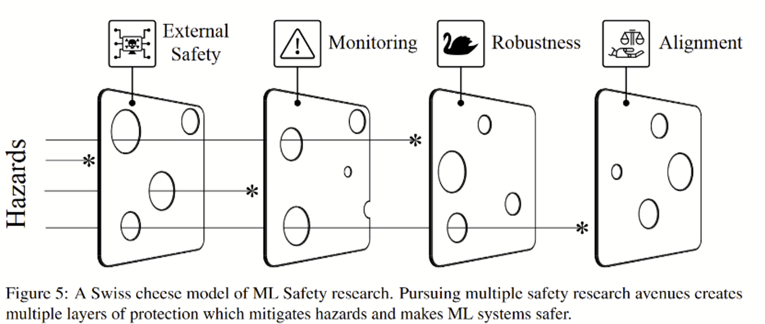
Unsolved problems in ml safety [Hendrycks et al 21]
1- Robustness
Black Swans (adapt to evolving environment, extreme/rare events)
Adversaries (handle diverse attacks, detect unforeseen ones, distribution shifts)
2- Monitoring
Anomaly detection (warn operators, flagging misuses)
Representative Models (calibration, when to override)
Hidden functionality (model Trojans, scan for capabilities)
3- Alignment
Specification (nebulous goals, complex objectives)
Optimization (multi-objective, trade-offs)
Brittleness (prevent overoptimization, proxy gaming/reward hacking)
Unintended Consequences (emergent power-seeking goals, cautious and constrained behavior)
4- External Safety
ML for cybersecurity (patching and detecting attacks)
Informed decision making (forecast events and effects, raise concerns)
Hendrycks et al., 2021, Unsolved problems in ml safety. In arXiv preprint arXiv:2109.13916
Notes:
Dan Hendrycks, Nicholas Carlini, John Schulman and Jacob Steinhardt. Unsolved problems in ml safety. In arXiv preprint arXiv:2109.13916, 2021.
https://www.hpi.uni-potsdam.de/giese/bibadmin/show.php?id=17717
https://arxiv.org/pdf/2109.13916.pdf

Slide 9
Challenges of Real-World Reinforcement Learning [Dulac-Arnold 2019]
Training off-line from fixed logs of an external behavior policy
pre-train policy & failure model
Learning on the real system from limited samples (
update policy and failure model)
Safety constraints that should never or at least rarely be violated
which combination of actions are allowed for a given context (system configuration)
Tasks that may be partially observable, alternatively viewed as non-stationary or stochastic.
Failure Propagation and Failure Masking POMDP
Inference that must happen in real-time at the control frequency of the system.
Allow environment and controller to operate in parallel (today they are in lock-step)
Dulac-Arnold, Mankowitz, Hester, 2019, Challenges of Real-World Reinforcement Learning
Notes:
Dulac-Arnold, Mankowitz, Hester, 2019, Challenges of Real-World Reinforcement Learning
Amodei et al., 2016, Concrete Problems in AI Safety - https://arxiv.org/abs/1606.06565

Slide 10
Challenges of Real-World Reinforcement Learning [Dulac-Arnold 2019]
Other challenges (not subjected to)
High-dimensional continuous state and action spaces.
Reward functions that are unspecified, multi-objective, or risk-sensitive.
System operators who desire explainable policies and actions.
Large and/or unknown delays in the system actuators, sensors, or rewards
Main reason-why:
mRubis is not safety-critical and it does not operate within a physical process
Dulac-Arnold, Mankowitz, Hester, 2019, Challenges of Real-World Reinforcement Learning

Slide 11
Recap - Sparse, Unsafe, Uncertain World
Operation produces few if any training examples (relevant events are rare)
Predictive performance is necessary but not sufficient
Simulation requirements for robustness are functions of the operational context, hence:
Requirements are domain-specific, which make them more challenging to automate
Their reification happens outside the machine learning algorithms
Requirements Engineering Questions
Which simulation requirements do we need?
How do we verify that these simulation requirements are being met?
How to incorporate these simulation requirements into training?
How do we transfer the simulation outcomes to production?

Slide 12
Deep Neural Network Challenges
Challenge | Description [0]
Brittleness (small deviations in the original input distribution cause incorrect predictions) | Fastening stickers on a stop sign can make an AI misread it [1]. Changing a single pixel on an image can make an AI think a horse is a frog [2]. Neural networks can be 99.99 percent confident that multicolor static is a picture of a lion [3]. Medical images can get modified in a way imperceptible to the human eye so medical scans misdiagnose cancer 100 percent of the time systems can break down in ways that remain a mystery to researchers [4]. Mitigation – train NN with "adversarial" examples.
Embedded Bias (unfair decisions made on invalid features) | Nationally deployed health care algorithm in the US was racially biased in favor of white males [5]. Mitigation – techniques for detecting unfair decision models
Catastrophic Forgetting (unlearns previous knowledge when learning new knowledge) | When trained to identify new deepfakes, the neural network quickly forgot how to detect the old ones. [6] Mitigation - mix new and old data in the training.
Notes:
[0] https://spectrum.ieee.org/ai-failures
[1] https://ieeexplore.ieee.org/document/8578273
[2] https://arxiv.org/abs/1710.08864
[3] http://anhnguyen.me/project/fooling/
[4] https://spectrum.ieee.org/the-human-os/biomedical/imaging/medical-imaging-ai-software-vulnerable-to-covert-attacks
[5] https://spectrum.ieee.org/racial-bias-found-in-algorithms-that-determine-health-care-for-millions-of-patients
[6] https://spectrum.ieee.org/what-is-deepfake
[7] http://anhnguyen.me/project/sam/
[8] https://spectrum.ieee.org/fatal-tesla-autopilot-crash-reminds-us-that-robots-arent-perfect
[9] https://www.tesla.com/blog/tragic-loss
[10] https://arxiv.org/abs/2011.06225
[11] https://www.sciencedirect.com/science/article/pii/S0010482521002122
[12] https://arxiv.org/abs/2005.02439
[13] https://arxiv.org/abs/2010.12779
[14] https://viterbischool.usc.edu/news/2020/11/new-test-reveals-ai-still-lacks-common-sense/
[15] https://arxiv.org/abs/2103.03874

Slide 13
Deep Neural Network Challenges
Challenge | Description [0]
Explainability (the way in which the NN produces certain predictions and not others) | Explanations are important to increase trust in the predictions and also to help debug the NN models. Typical questions are what factors most contributed to a person to be granted a loan or what are the basis of cancer diagnosis? Mitigation – Explainability techniques [7] and building databases of correct explanations or search for facts that might explain decisions.
Quantifying Uncertainty (NN can be very certain, even when it is wrong) | In the first Tesla fatal accident [8], the NN was completely certain to be seeing the sky and not a white truck crossing in front of the car [9]. Mitigation – Uncertainty Quantification Techniques [10][11], however techniques are too slow, we need faster techniques to be used in real-time safety-critical systems
Common Sense (the ability to reach acceptable, logical conclusions based the everyday knowledge that people take for granted) | NN can learn shortcuts that lead them to misbehave, like misclassifying hate speech, when a human could clearly identify it [12][13]. Mitigation – checklists and diverse training data [14]
Math (solve mathematical problems) | A NN was trained on hundreds of thousands of math problems with step-by-step solutions, but when tested on 12,500 problems from high school math competitions, the NN produced only 5% accuracy [15] . Mitigation - ?
Notes:
[0] https://spectrum.ieee.org/ai-failures
[1] https://ieeexplore.ieee.org/document/8578273
[2] https://arxiv.org/abs/1710.08864
[3] http://anhnguyen.me/project/fooling/
[4] https://spectrum.ieee.org/the-human-os/biomedical/imaging/medical-imaging-ai-software-vulnerable-to-covert-attacks
[5] https://spectrum.ieee.org/racial-bias-found-in-algorithms-that-determine-health-care-for-millions-of-patients
[6] https://spectrum.ieee.org/what-is-deepfake
[7] http://anhnguyen.me/project/sam/
[8] https://spectrum.ieee.org/fatal-tesla-autopilot-crash-reminds-us-that-robots-arent-perfect
[9] https://www.tesla.com/blog/tragic-loss
[10] https://arxiv.org/abs/2011.06225
[11] https://www.sciencedirect.com/science/article/pii/S0010482521002122
[12] https://arxiv.org/abs/2005.02439
[13] https://arxiv.org/abs/2010.12779
[14] https://viterbischool.usc.edu/news/2020/11/new-test-reveals-ai-still-lacks-common-sense/
[15] https://arxiv.org/abs/2103.03874

Slide 14
Deep Neural Network Challenges - References
[0] https://spectrum.ieee.org/ai-failures
[1] https://ieeexplore.ieee.org/document/8578273
[2] https://arxiv.org/abs/1710.08864
[3] http://anhnguyen.me/project/fooling/
[4] https://spectrum.ieee.org/the-human-os/biomedical/imaging/medical-imaging-ai-software-vulnerable-to-covert-attacks
[5] https://spectrum.ieee.org/racial-bias-found-in-algorithms-that-determine-health-care-for-millions-of-patients
[6] https://spectrum.ieee.org/what-is-deepfake
[7] http://anhnguyen.me/project/sam/
[8] https://spectrum.ieee.org/fatal-tesla-autopilot-crash-reminds-us-that-robots-arent-perfect
[9] https://www.tesla.com/blog/tragic-loss
[10] https://arxiv.org/abs/2011.06225
[11] https://www.sciencedirect.com/science/article/pii/S0010482521002122
[12] https://arxiv.org/abs/2005.02439
[13] https://arxiv.org/abs/2010.12779
[14] https://viterbischool.usc.edu/news/2020/11/new-test-reveals-ai-still-lacks-common-sense/
[15] https://arxiv.org/abs/2103.03874

Slide 15
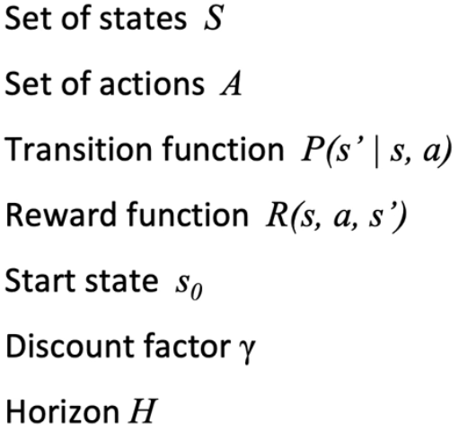
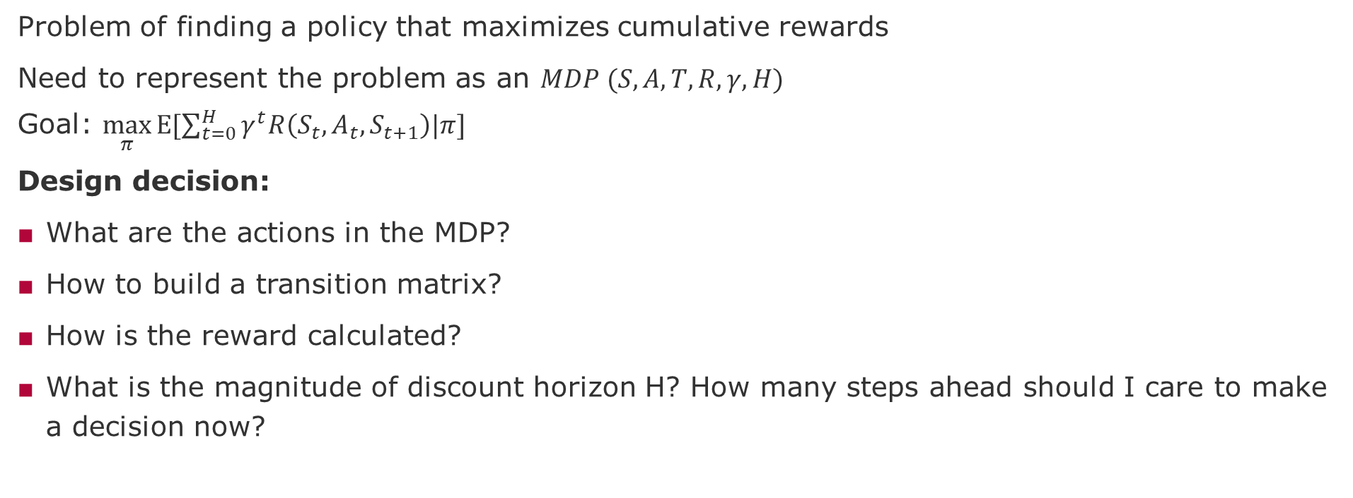
Challenges of modeling as RL problem
Problem of finding a policy that maximizes cumulative rewards
Need to represent the problem as an $MDP (S, A, T, R, γ, H)$
Goal: $\max_{π}{Ε[\sum_{t=0}^{H}{γ^{t}R\left(S_{t}, A_{t}, S_{t+1}\right)|π}]}$
Design decision:
What are the actions in the MDP?
How to build a transition matrix?
How is the reward calculated?
What is the magnitude of discount horizon H? How many steps ahead should I care to make a decision now?

Slide 16
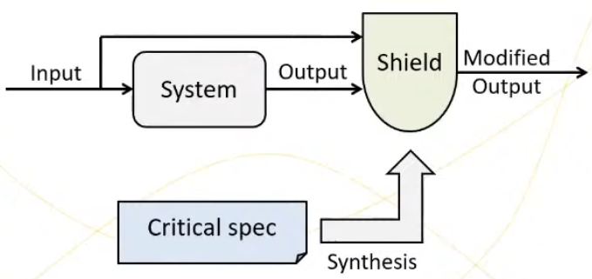
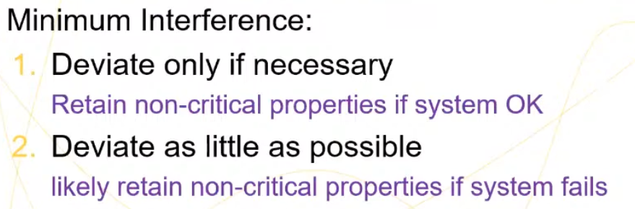
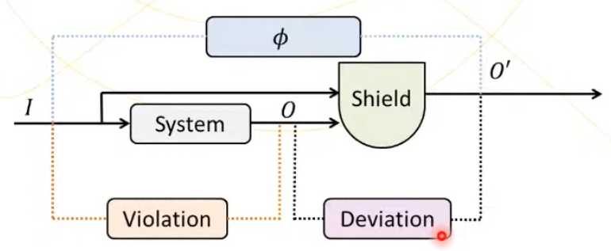
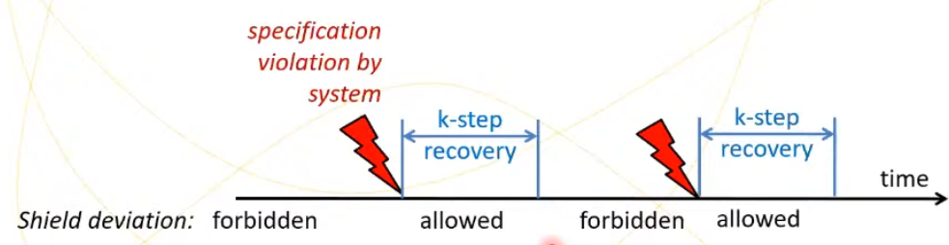
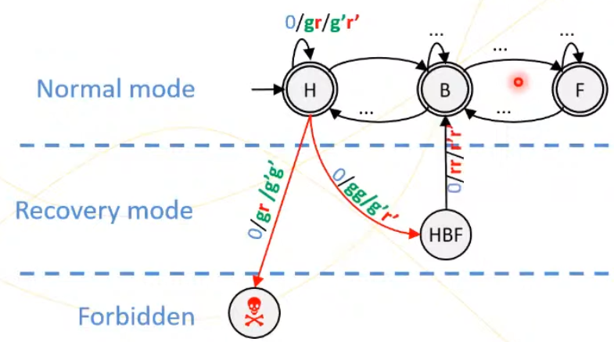
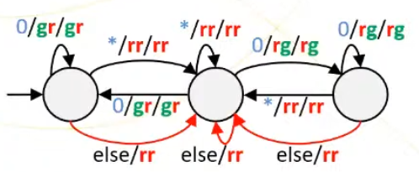
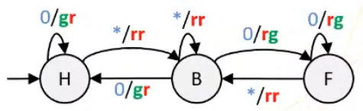
Shielding – Domain-Knowledge for Safe Learning
Specification
Label: input / system_output / shield_output
Other extensions:
Probabilistic shields
Performance shields
Timed shields (timed automata)
Multi-agent shields (global safety)
source: Shield Synthesis for Safe Reinforcement Learning, https://www.youtube.com/watch?v=DUkqNJ-rwck
Notes:
Shield for performance:
- difficulty to add new features (priority to public transport)
- poor performance on untrained behavior (learned on uniform traffic, deployed on rush-hour traffic)
no local fairness (farm road turns green eventually)
Time shields:
Complex timing is difficult to learn
Enforce it with shield from timed automata specs
Multi-agent shields (enforce global safety by quantitative interference costs):
- Counting cost function
Different costs for interferences with different agents
Fair shielding (do not always interfere with the same agent repeatedly)
What information is necessary to synthesize the shield?
System and environment are adversarial. It does not need any information of any.
Prior knowledge that guarantees safe learning operation enforce by the shield like the flight envelope.
Shield could be a robust control, that provide guarantees at the expense of loss of optimality.
Related to Runtime Verification (He’s work).
TODO: Add Shield as one approach. Add other approaches from safety-critical community.

Slide 17


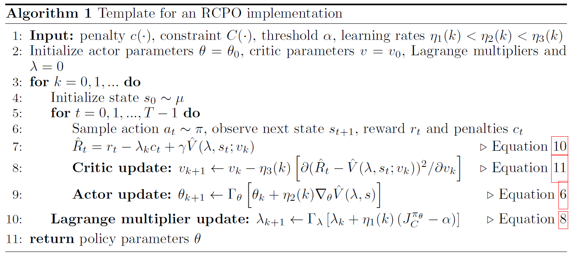
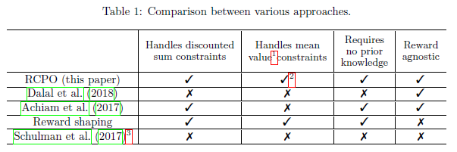
Constrained MDP approach to Safe RL [Tessler 2018]
Constrained Markov Decision Process (CMDP) extends the MDP framework by introducing a penalty c(s; a), a constraint
The expectation of the constraint:
The objective becomes:
Parametrized policies (neural networks), where the parameters of the policy are denoted by $θ$ and a parametrized policy as $π_{θ}$. And follow the two assumptions to ensure convergence to a constraint satisfying policy.
Chen Tessler, Daniel J. Mankowitz, and Shie Mannor, 2018, Reward Constrained Policy Optimization
Notes:
Chen Tessler, Daniel J. Mankowitz, and Shie Mannor, 2018, Reward Constrained Policy Optimization https://arxiv.org/abs/1805.11074

Slide 18
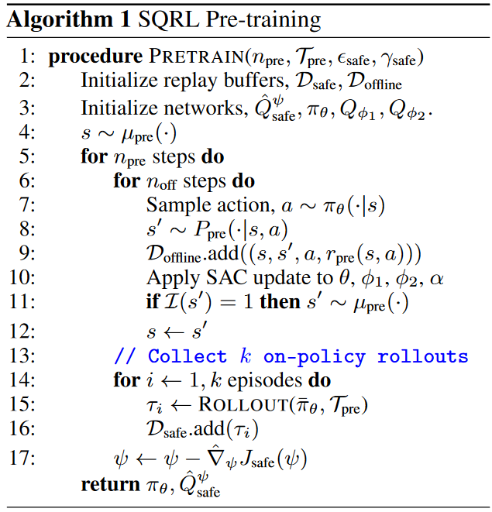
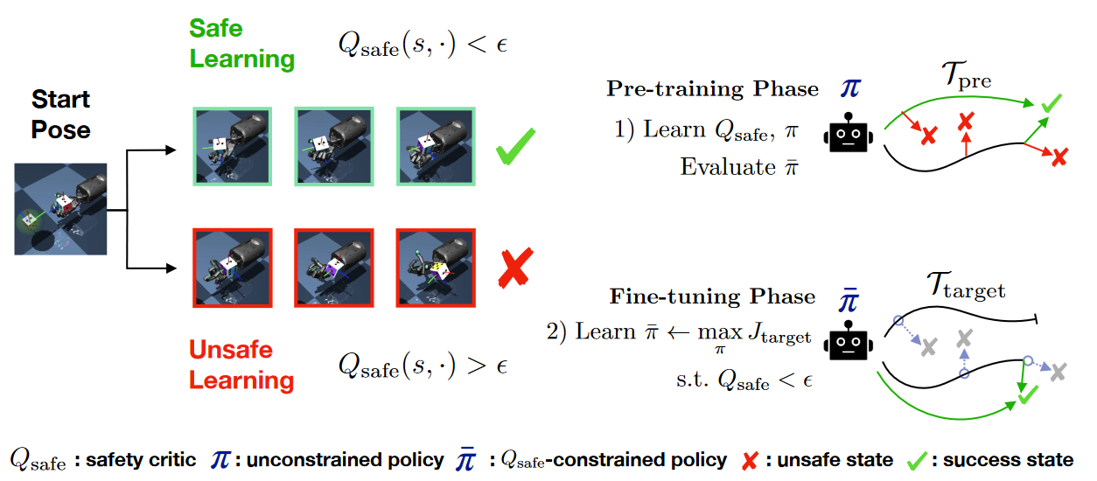
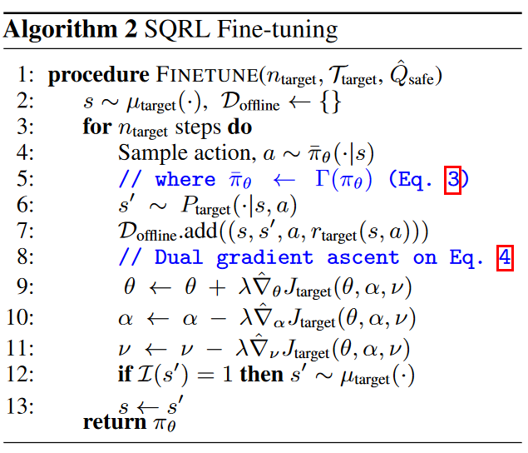
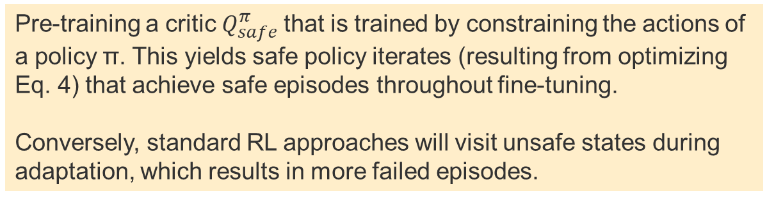
Learning to be Safe with a Safety Critic [Srinivasan 2020]
Pre-training a critic $Q_{safe}^{π}$that is trained by constraining the actions of a policy π. This yields safe policy iterates (resulting from optimizing Eq. 4) that achieve safe episodes throughout fine-tuning.
Conversely, standard RL approaches will visit unsafe states during adaptation, which results in more failed episodes.
Srinivasan et al. ,2020, Learning to be Safe: Deep RL with a Safety Critic
Notes:
Srinivasan et al. ,2020, Learning to be Safe: Deep RL with a Safety Critic https://arxiv.org/abs/2010.14603

Slide 19
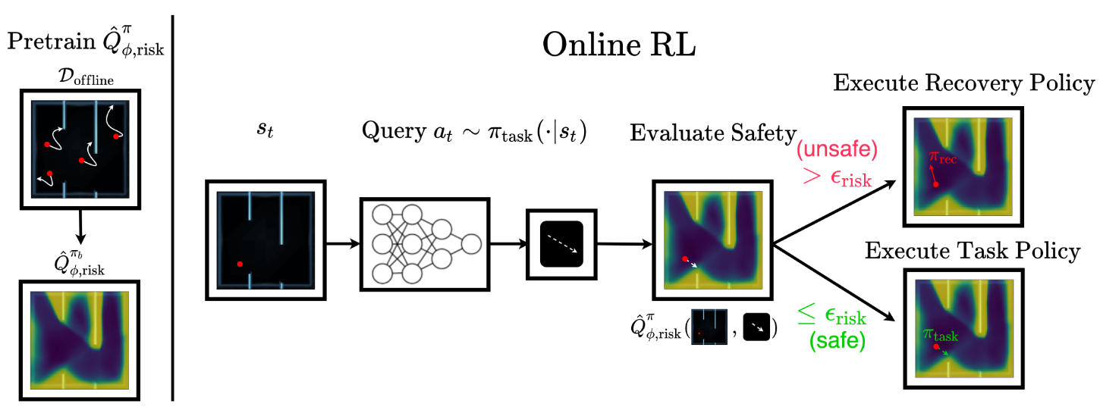
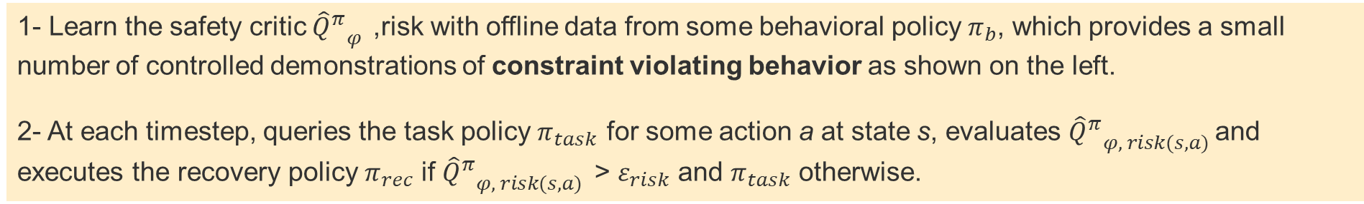
Recovery RL: Safe Reinforcement Learning with Learned Recovery Zones [Thananjeyan 2021]
1- Learn the safety critic ${{{\hat{Q}}^{π}}_{φ}}^{ }$,risk with offline data from some behavioral policy $π_{b}$, which provides a small number of controlled demonstrations of constraint violating behavior as shown on the left.
2- At each timestep, queries the task policy $π_{task}$ for some action a at state s, evaluates ${{{\hat{Q}}^{π}}_{φ, risk(s,a)}}^{ }$and executes the recovery policy $π_{rec}$ if ${{{\hat{Q}}^{π}}_{φ, risk(s,a)}}^{ }$> $ε_{risk}$ and $π_{task}$ otherwise.
Thananjeyan et al., 2021, Recovery RL: Safe Reinforcement Learning with Learned Recovery Zones
Notes:
Thananjeyan et al., 2021, Recovery RL: Safe Reinforcement Learning with Learned Recovery Zones, https://arxiv.org/pdf/2010.15920.pdf

Slide 20
Next Tasks (papers are in the Zotero repo)
1. Safety Challenges in AI and RL
- Dulac-Arnold, Mankowitz, Hester, 2019, Challenges of Real-World Reinforcement Learning
- Amodei et al., 2016, Concrete Problems in AI Safety - https://arxiv.org/abs/1606.06565
2. Choose one of the Safety-RL papers to read and write a gist (8 lines)
Context (domain and how it might relate to mRubis)
Problem (what, why it matters, why is it challenging)
Approach (why is it a good idea/insight, how it works, how it compares with others)
3. Choose one of the Sim2Real papers and write a gist (8 lines)
For tasks 2 and 3, please check the following folders in Zotero:
Safety (reinforcement learning)
Sim2Real

Slide 21
END

Slide 22
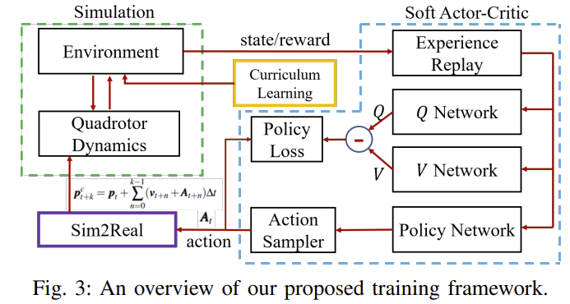
Further readings recommended
Traoré, R., Caselles-Dupré, H., Lesort, T., Sun, T., Díaz-Rodríguez, N., & Filliat, D. (2019). Continual reinforcement learning deployed in real-life using policy distillation and sim2real transfer
Xiao, C., Lu, P., & He, Q. (2021). Flying Through a Narrow Gap Using End-to-End Deep Reinforcement Learning Augmented With Curriculum Learning and Sim2Real.
IEEE Transactions on Neural Networks and Learning Systems.
Read in more detail and check citations
Kaspar, M., Osorio, J. D. M., & Bock, J. (2020). Sim2real transfer for reinforcement learning without dynamics randomization. In 2020 IEEE/RSJ International Conference on Intelligent Robots and Systems (IROS) (pp. 4383-4388). IEEE.
Kadian, A., Truong, J., Gokaslan, A., Clegg, A., Wijmans, E., Lee, S., ... & Batra, D. (2020). Sim2Real predictivity: Does evaluation in simulation predict real-world performance?. IEEE Robotics and Automation Letters, 5(4), 6670-6677.
Balaji, B., Mallya, S., Genc, S., Gupta, S., Dirac, L., Khare, V., ... & Karuppasamy, D. (2019). Deepracer: Educational autonomous racing platform for experimentation with sim2real reinforcement learning. arXiv preprint arXiv:1911.01562.
How to prevent catastrophic forgetting in sim2real

Slide 23
Preliminary Work-Packages
1- Hidden Markov Model
Study how to move the HMM implemented in the Python side to the Java side
2- Failure Inject Mechanism
Study how to generate failure injects that reflect that failure propagation patterns
3- Reinforcement Learning
Study how to replace the Supervised Learning controller (Regression) with a Self-Supervised One (RL)
4- Monitoring
Study how to visualize the utility, risk, and mechanism gap between the Real and Simulated (Digital-Twin)
5- Adversarial Tests
Study how to generate stress tests that show how policies that have equivalent predictive outcome at training present distinct outcomes at adversarial test sets

Slide 24
Project Goals - Research Problems
1- Under-specification Problem
Goal: Show that different prediction models solve the task well for testing data, however, perform very differently in two distinct situations:
1.1 distinct hyper-parameters (prior knowledge)
1.2 out-of-distribution data (distribution shifts)
2- Value-at-Risk Problem
Goal: Show different rates of synchronization between Production and Simulation can lead to:
2.1 excessive cost of training and redeployment
2.2 increase in the risk of under-performance
3- Learning to Synchronize Problem
Goal: Show that different strategies to learn when to train and redeploy require:
3.1 more data to achieve an average value-at-risk
3.2 longer time to converge
Simulation
Sim2Real
Feedback Loop

